Slide 1
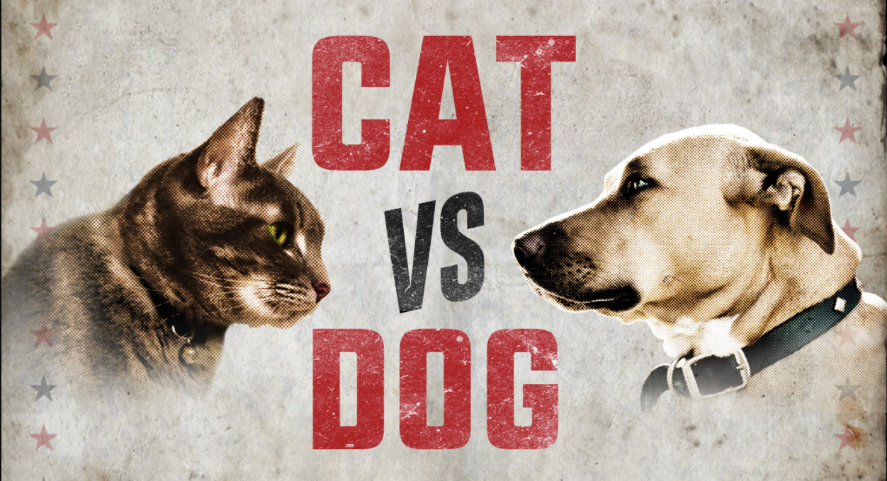
Cat vs Dog Image Classification using VGG-19 Transfer Learning and Fine Tuning
Nitin Kumar

Slide 2
Problem Statement
We have to create an image classification model to classify between images of cats and dogs.
We have 20,000 images for training, 5,000 for validation.
Each image has dimensions of 150 x 150.
Sample Images

Slide 3
Approach
For this binary problem statement, I am going to use VGG-19 model using imagenet weights.
Image Augmentation will be applied to training images.
To achieve low validation-loss and high binary_accuracy a two-step training program will be implemented.
I am going to use TensorFlow - Keras API for model training.
For this project, I am going to use Google Collab environment.

Slide 4
VGG-19 Model
Released in 2014 by the Visual Geometry Group at the University of Oxford, this family of architectures achieved second place for the 2014 ImageNet Classification competition.
It is noteworthy for its extremely simple structure, being a simple linear chain of layers, with all the convolutional layers having a kernel size of 3x3. Despite this simple structure, it achieves competitive classification accuracy compared to more complicated nets (such as GoogLeNet), although at the cost of slower evaluation speed and much larger net size.
This model achieves 75.2% top-1 and 92.5% top-5 accuracy on the ImageNet Large Scale Visual Recognition Challenge 2012 dataset.

Slide 5
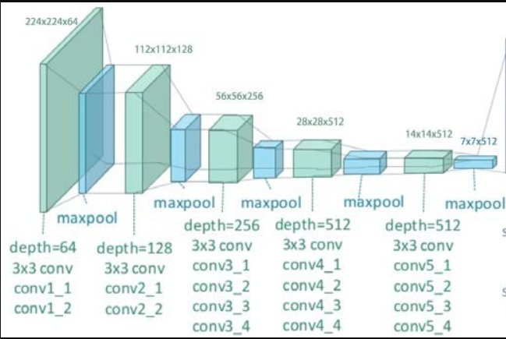
Customized VGG-19 Model Architecture
Sigmoid Prediction layer
Output

Slide 6
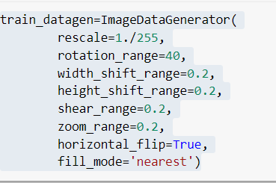
Image Processing and Augmentation
For training images, various image augmentation techniques are used to generate new images.
Train, Validation and Test images are loaded using Image Data Generator.

Slide 7
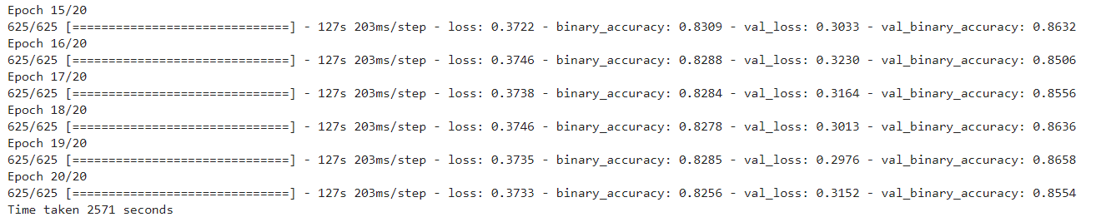
Model Compilation, Training and Result - 1
For model compilation, we are going to use binary cross-entropy as loss, Adam optimizer and Binary Accuracy as metrics.
Early stopping call back is used to monitor val_loss with the patience of 10.
The model is trained for 20 epochs with batch size as 32.
Here are the last 5 rows from model training.

Slide 8
Model Compilation, Training and Result - 2
For model compilation, we are going to use binary cross-entropy as loss, Adam optimizer and Binary Accuracy as metrics.
For this step, we are going to reduce the learning_rate to ‘le-5’.
Early stopping call back is used to monitor val_loss with the patience of 5.
Custom callback is used to stop training if binary_val_accuracy > 0.99.
The model is trained for 20 epochs with batch size as 32.
Model training stop after epochs.
Final Model Results:
Training_loss:
Training_accuracy:
Val_loss:
Val_accuracy:

Slide 9
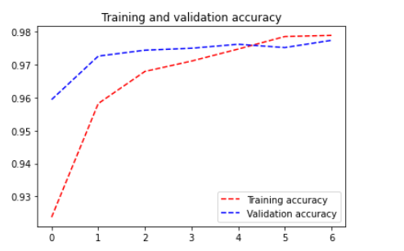
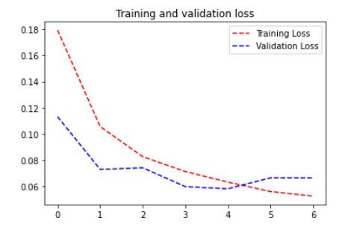
Training Graph:
***Please Keep Note of the Scales

Slide 10
Sources
https://resources.wolframcloud.com/NeuralNetRepository/resources/VGG-19-Trained-on-ImageNet-Competition-Data
https://keras.io/guides/transfer_learning/

